Slide 1
CSE 2451 Programming Environment
Zichen Zhang

Slide 2
Overview
UNIX – Linux introduction
Windows Subsystem for Linux (WSL)
Setup Linux virtual machine
Student Linux server of OSU
UNIX/Linux commands
gcc commands

Slide 3
UNIX
UNIX is a multi-user and multi-tasking operating system
Multi-user: Multiple users can use the system at the same time
Multi-tasking: Multiple processes (programs) can run at the same time
UNIX is originally developed with assembly language and later reimplemented with C – C starts to gain popularity
Our course’s programming environment is UNIX/Linux

Slide 4
How do I get access to UNIX?
UNIX has some free version for development use
Use Linux instead of UNIX, it’s a “clone” of UNIX without using its code, a free and open-source alternative to proprietary UNIX system
Install Windows Subsystem for Linux (WSL) with default Ubuntu distribution of Linux (https://docs.microsoft.com/en-us/windows/wsl/install-win10) – no graphic user interface
Install a Linux virtual machine – with graphic user interface
OSU provides student Linux server for students to use - supports both ssh access and GUI

Slide 5
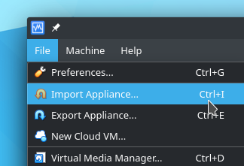
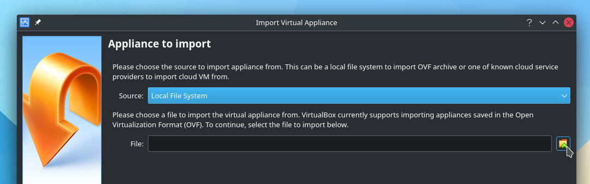
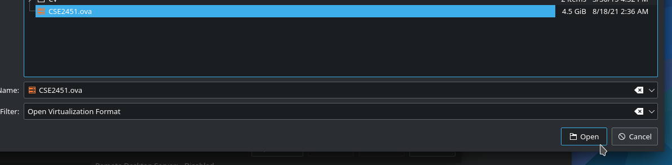
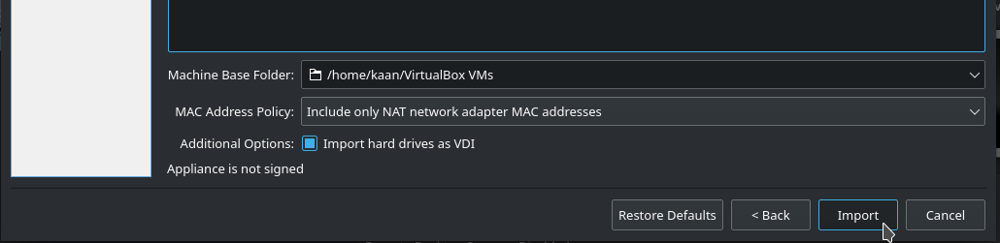
Install Linux Virtual Machine
This is a virtual machine with Ubuntu OS that contains a complete development environment for C
Download and Install VirtualBox
Download the virtual machine image from the class page
Load virtual machine image
Open VirtualBox
Select File -> Import Appliance
Select virtual machine image you downloaded
Complete the import

Slide 6
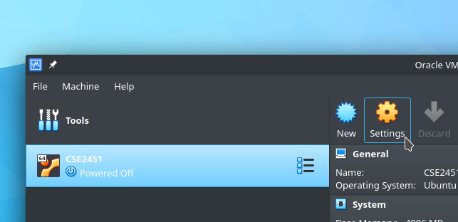
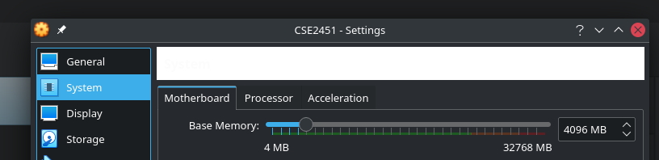
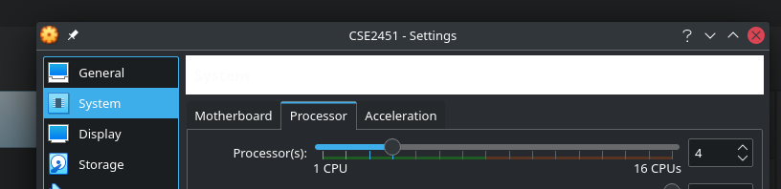
Configuration of Virtual Machine
Adjust the CPU and memory available to the virtual machine
Go to settings -> System -> motherboard -> processor
Try to set these as high as possible while remaining in the green zone

Slide 7
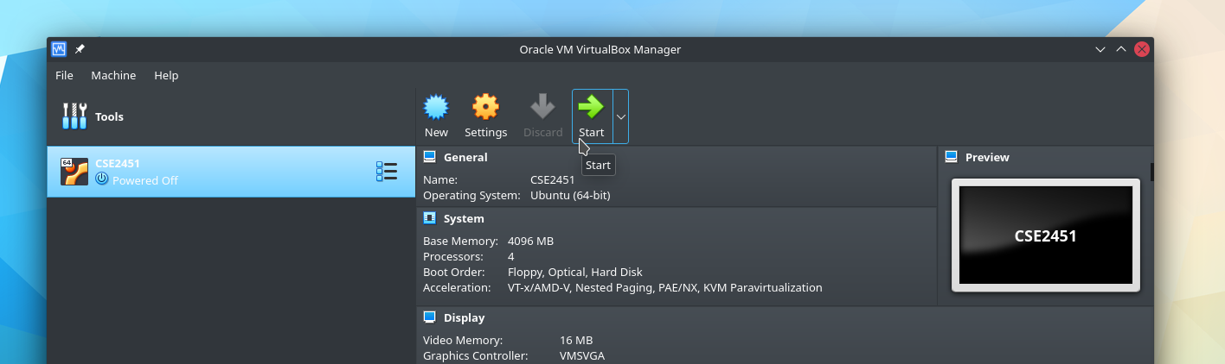
Start the Linux Virtual Machine
Open VirtualBox
Click on the cse2451 virtual machine to select it
Click the associated green arrow to start the virtual machine
Username: cse2451
Password: cse2451

Slide 8
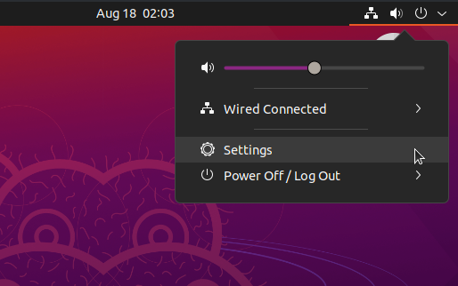
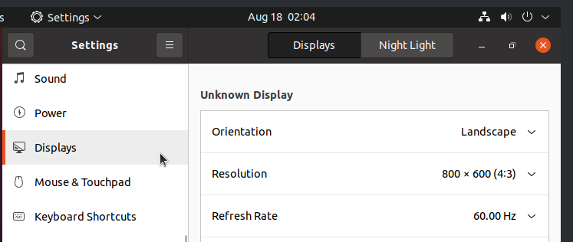
Display Size of Virtual Machine Screen
The display resolution may be too low when you first start the machine
Click on the top right power off button -> settings - > display
Then adjust the screen resolution to fit your monitor

Slide 9
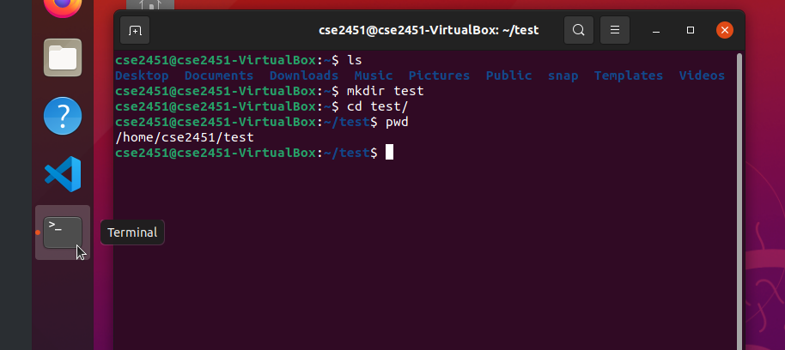
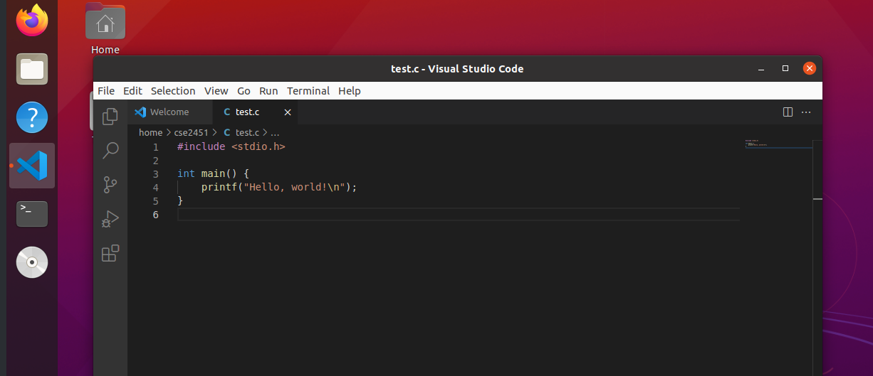
Programs used in Virtual Machine
Key programs
Linux terminal: an efficient command-based way to interact with a computer
Visual Studio Code: a free, open-source text editor and development environment
terminal
Visual Studio Code

Slide 10
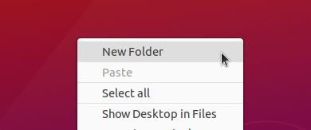
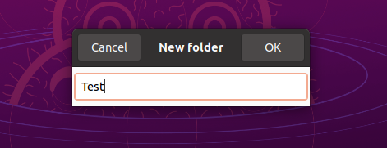
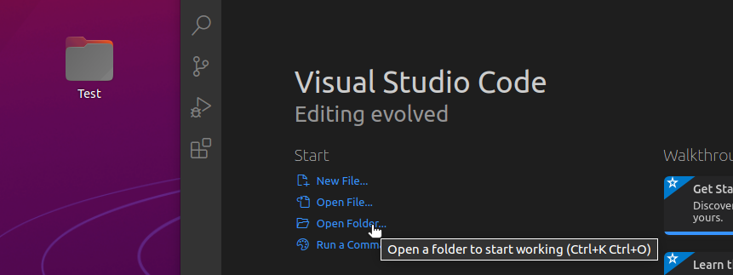
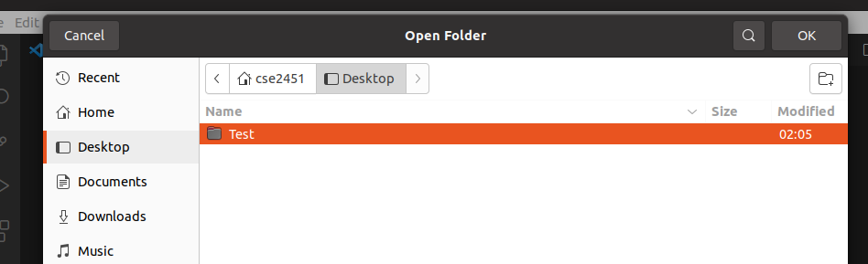
Using Visual Studio Code
Create a new folder – your project folder
Launch Visual Studio Code from the side bar
Click on open folder in VS code
Pick the newly created project folder

Slide 11
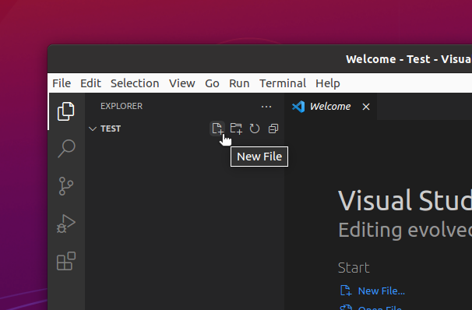
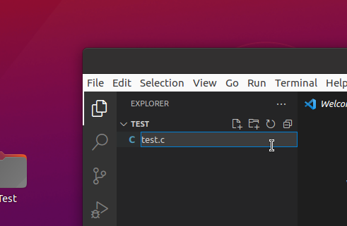
Using Visual Studio Code
To start coding, create a new file in VS code
Name the file, ending with “.c”
Write your code in the newly created .c file

Slide 12
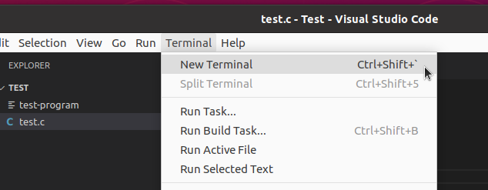
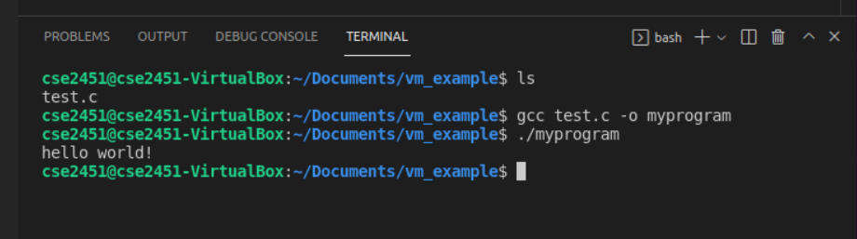
Using Visual Studio Code
Click on Terminal on the menu bar of VS code
Select New Terminal (An alternative to the actual terminal program, which might be easier to use.)
You can then compile and run your code

Slide 13
Access Student Linux Server – no GUI
Setup Pulse Secure VPN for off-campus remote access
Download Pulse Secure VPN here
Installation guide here:
Windows
MacOS
Download Duo Mobile (verification app)
Connect Pulse Secure VPN with your OSU student account
Open a terminal on your own computer
Windows: command prompt or PowerShell
MacOS: terminal
Remote access student Linux Server via ssh in terminal
Server address: stdlinux.coeit.osu.edu
Type the following command in your terminal: ssh name.number@stdlinux.coeit.osu.edu
Replace name.number with your OSU student username dot number, e.g., zhang.9325
Enter your OSU account password in the follow up prompt
Additional information on remote access: https://cse.osu.edu/computing-services/resources/remote-access

Slide 14
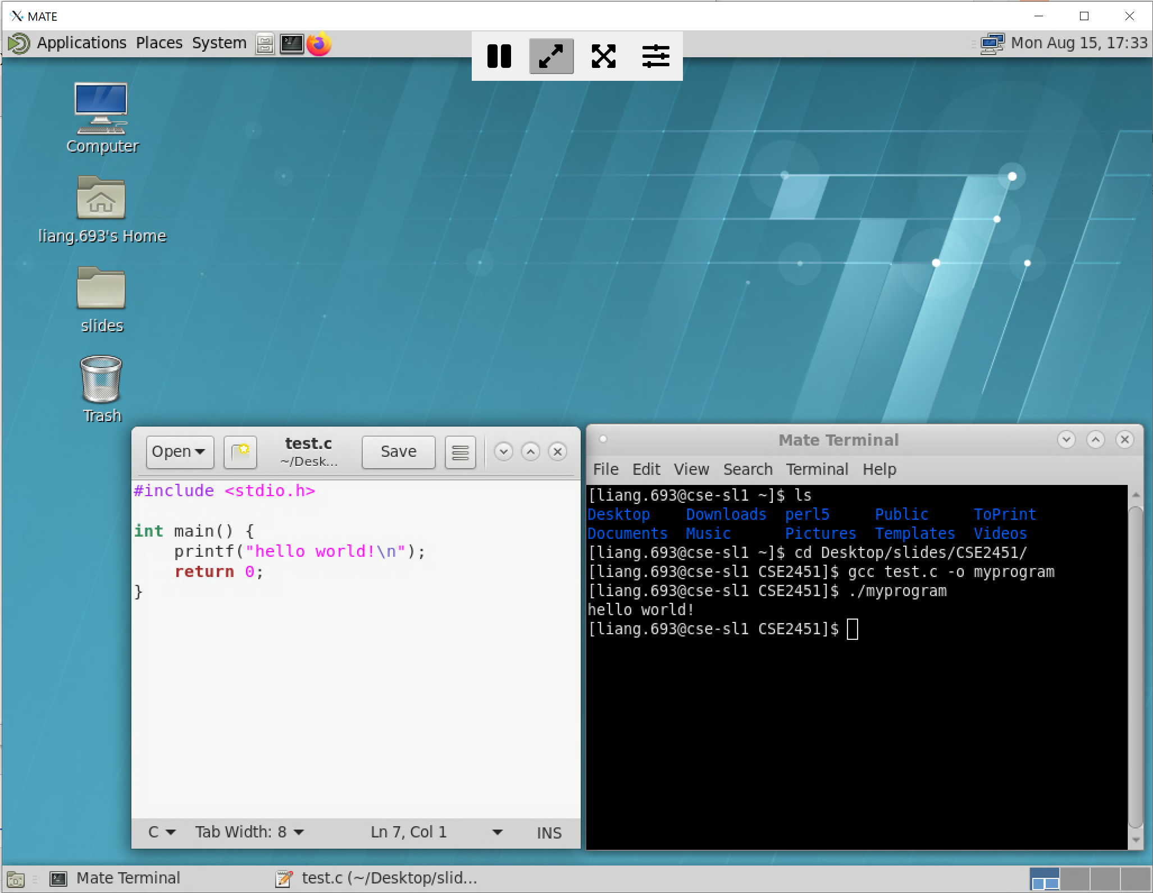
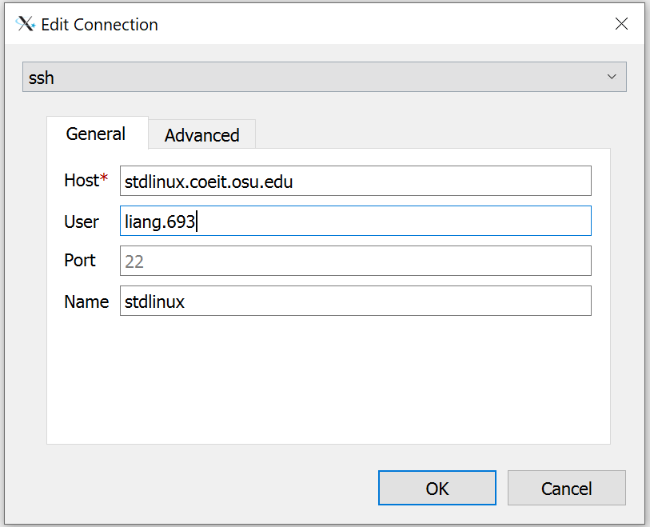
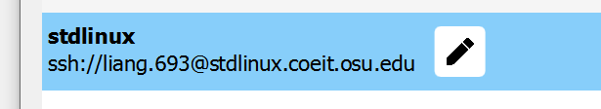
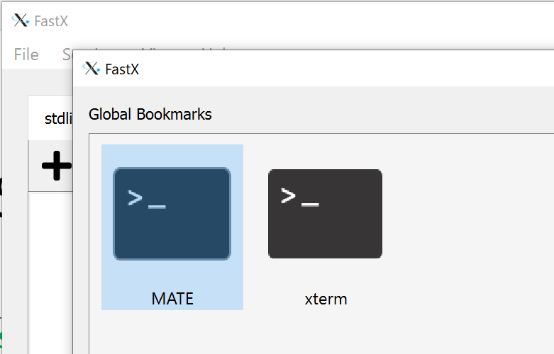
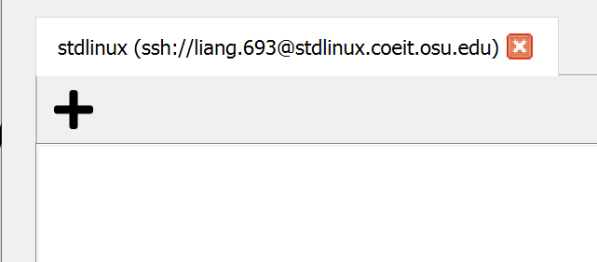
Access Student Linux Server – with GUI
Setup Pulse Secure VPN for off-campus remote access
The same as previous slides
Setup FastX
Download FastX here
FastX installation guide here
Remote access student Linux Server via FastX
Create a FastX connection to student Linux server, replace the user with your own name.number
Launch the connection by double click and enter your OSU student account’s password
After login, click on the + button
Select MATE in the pop-up window to enter GUI

Slide 15
UNIX/Linux Commands – navigation
Basic commands
Command | Meaning
ls | list files and directories
mkdir directory | make a directory
cd directory | change to named directory
cd | change to home-directory
cd .. | change to parent directory
pwd | display the path of the current directory

Slide 16
UNIX/Linux Commands – file manipulation
More useful commands
Command | Meaning
cp file1 file2 | copy file1 and call it file2
mv file1 file2 | move or rename file1 to file2
rm file | remove a file
rmdir directory | remove an empty directory
cat file | display a file
less file | display a file a page at a time
grep 'keyword' file | search a file for keyword
touch file | Create a file named file

Slide 17
UNIX/Linux Commands – redirect input/output
More useful commands
Command | Meaning
command > file | redirect standard output to a file
command >> file | append standard output to a file
command < file | redirect standard input from a file
command1 | command2 | pipe the output of command1 to the input of command2
cat file1 file2 > file0 | concatenate file1 and file2 to file0
sort file | sort file data line-by-line
who | list users currently logged in
cat file1 file2 | grep keyword:
Concatenate file1 and file2, then pipe the output to search for keyword

Slide 18
UNIX/Linux Commands
Manual pages give information about commands, C libraries, functions, and more
Type man <name> at the terminal to read the manual
man gcc
man 3 printf
man man
Specifies the section numbers of the manual about printf (e.g., 1 for executable programs, 2 for system calls, 3 for library calls )
Use man command to tell you how to use the man command

Slide 19
How to stop a process?
Foreground processes: Press CONTROL and C
Background processes:
ps:
shows running programs
pkill program:
Asks program to stop.
pkill -9 program:
Forces program to stop, use with caution. It can get really ugly if you kill a wrong program

Slide 20
Text Editors
Terminal Editors
nano
Emacs
vim
Graphic Editors
Visual Studio Code
gedit Text Editor
Emacs

Slide 21
UNIX Tutorial Resources
http://www.ee.surrey.ac.uk/Teaching/Unix
http://www.math.utah.edu/lab/unix/unix-tutorial.html
http://www2.ocean.washington.edu/unix.tutorial.html

Slide 22
Compile Source Code and Run Program
Open a terminal
Navigate to the folder storing your source code with cd command:
cd /home/zhang.9325/Downloads
Use gcc to build your program (enter the following cmd in terminal):
program we are running
Input arguments we are passing to the program (gcc)
gcc hello.c –o myprogram –std=c99
Building tools:
gcc/clang
Source file path
-o myprogram:
-o specifying the following argument (myprogram) is the name of the output file
-std=c99:
specifying which standard (c99) the gcc compiler should use to convert the C code to executable program

Slide 23
Compile Source Code and Run Program
program we are running
Input arguments we are passing to the program (gcc)
gcc hello.c –o myprogram –std=c99
Building tools:
gcc/clang
Source file path
-o myprogram:
-o specifying the following argument (myprogram) is the name of the output file. If –o not given, the default output file is a.out
Flexble suffix: out.o; out.out; out
-std=c99:
specifying which standard (c99) the gcc compiler should use to convert the C code to executable program. The default, if no C language dialect options are given, is -std=gnu17.
gcc [-c|-S|-E] [-std=standard]
gcc hello.c
Default output: a.out

Slide 24
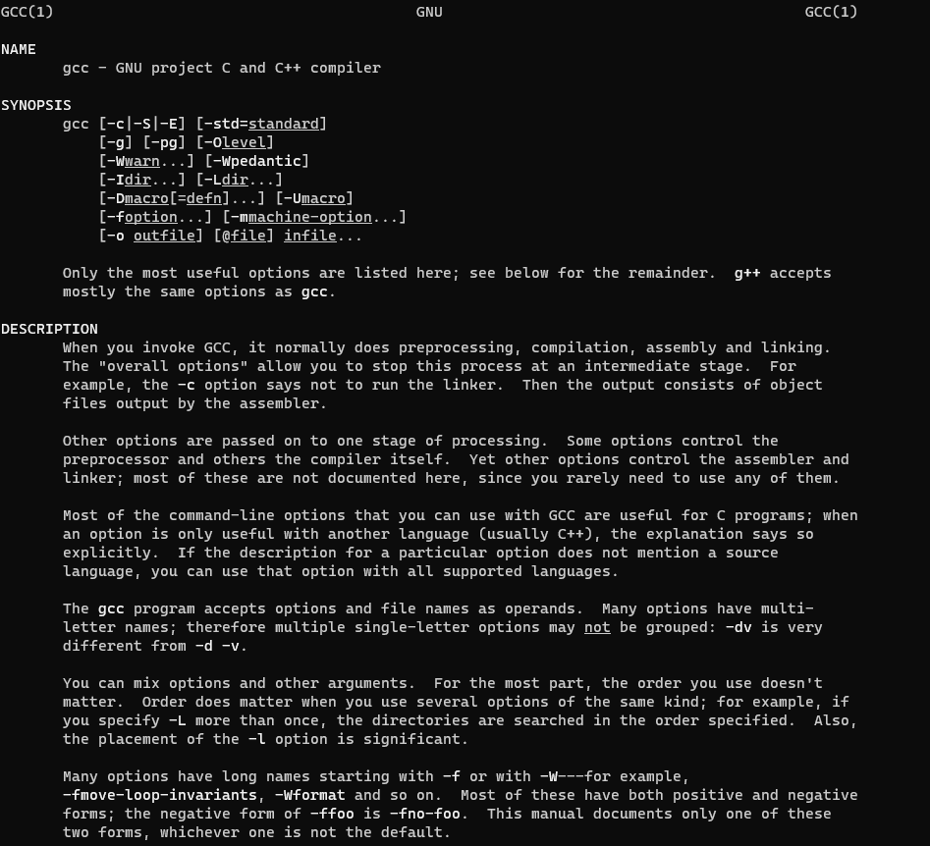
man gcc

Slide 25
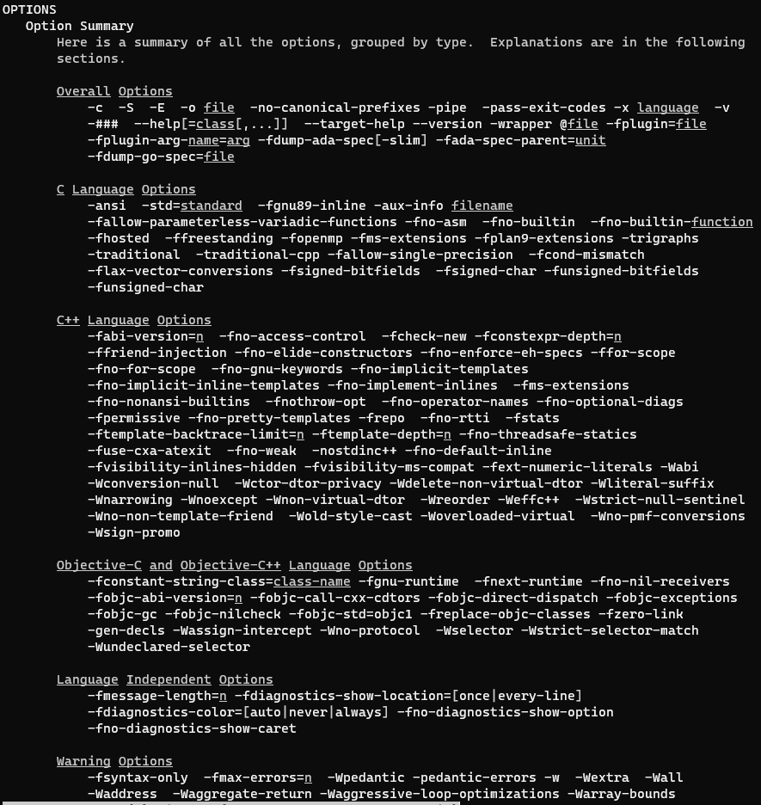

Slide 26
Compile Source Code and Run Program
Successful compilation/build of the program -> no return error message displays in terminal
The output program file should be at the same directory of the source code unless specified otherwise
At the directory of the executable program file (named “myprogram”), run the following command in terminal:
./myprogram

